Slide 1
UNIT 2
TYPES ,OPERATORS AND EXPRESSIONS

Slide 2
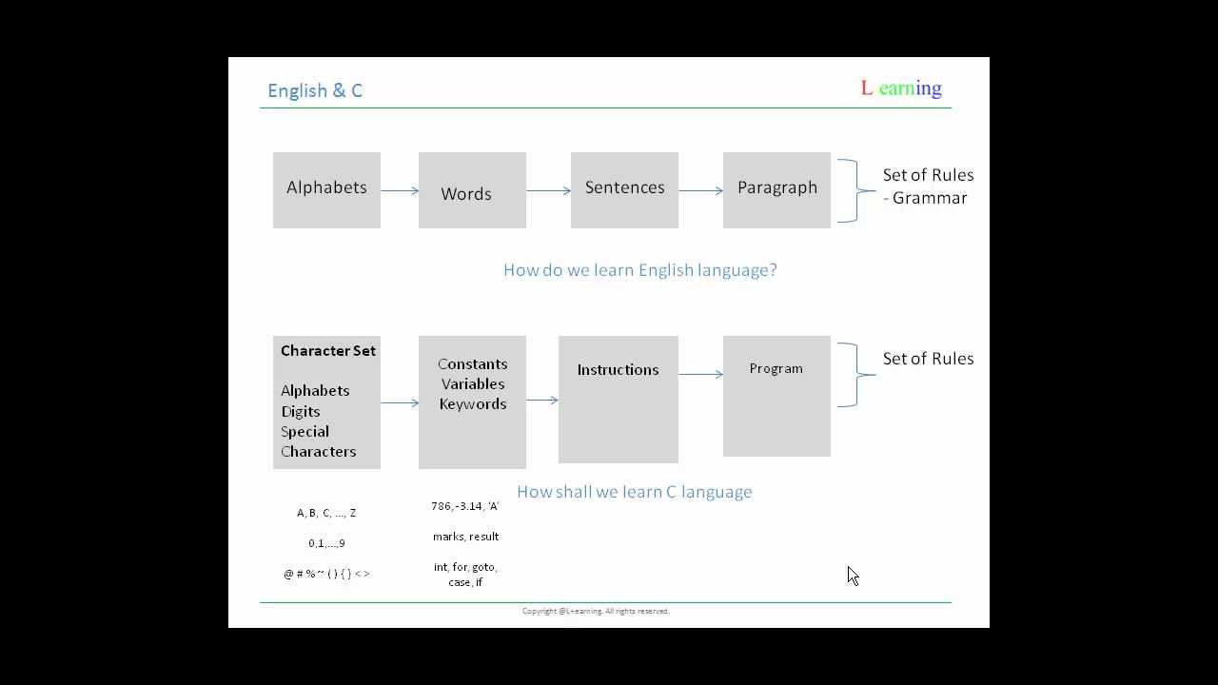
Similarities Between C and English

Slide 3
Structure of a C program
#include <stdio.h>
#include<conio.h>

Slide 4
Header Files Inclusion
The file containing the definitions and prototypes of the functions being used in the program are called a header file.
It is also known as a library file.
The first and foremost component is the inclusion of the Header files in a C program. A header file is a file with extension .h which contains C function declarations and macro definitions to be shared between several source files.
Some of C Header files:
stdint.h – Defines exact width integer types.
stdio.h – Defines core input and output functions
stdlib.h – Defines numeric conversion functions, pseudo-random network generator, memory allocation
string.h – Defines string handling functions
math.h – Defines common mathematical functions
conio.h- library functions (clrscr(),getch(),getche(),textcolor(),textbackground())

Slide 5
Structure of a C program
#include <stdio.h>
#include<conio.h>
void main()

Slide 6
main()
main() function is the entry point of any C program.
It is the point at which execution of program is started.
When a C program is executed, the execution control goes directly to the main() function.
Every C program have a main() function.
void: is a keyword in C language, void means nothing, whenever we use void as a function return type then that function nothing return. here main() function no return any value.
In place of void we can also use int return type of main() function, at that time main() return integer type value.
main: is a name of function which is predefined function in C library.

Slide 7
Structure of a C program
#include <stdio.h>
#include<conio.h>
Void main()
{
}

Slide 8
Memory Units
S.No. | Unit & Description
1 | Bit (Binary Digit) A binary digit is logical 0 and 1 representing a passive or an active state of a component in an electric circuit.
2 | Nibble A group of 4 bits is called nibble.
3 | Byte A group of 8 bits is called byte. A byte is the smallest unit, which can represent a data item or a character.
4 | Word A computer word, like a byte, is a group of fixed number of bits processed as a unit, which varies from computer to computer but is fixed for each computer. The length of a computer word is called word-size or word length. It may be as small as 8 bits or may be as long as 96 bits. A computer stores the information in the form of computer words.

Slide 9
S.No. | Unit & Description
1 | Kilobyte (KB) 1 KB = 1024 Bytes
2 | Megabyte (MB) 1 MB = 1024 KB
3 | GigaByte (GB) 1 GB = 1024 MB
4 | TeraByte (TB) 1 TB = 1024 GB
5 | PetaByte (PB) 1 PB = 1024 TB

Slide 10
Structure of a C program
#include <stdio.h>
#include<conio.h>
Void main()
{
int ;
char ;
float ;
}

Slide 11
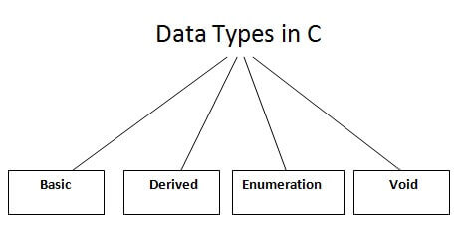
Data Types in C
A data type specifies the type of data that a variable can store such as integer, floating, character, etc.

Slide 12
Data Types in C
There are the following data types in C language.
Types | Data Types
Basic Data Type | int, char, float, double
Derived Data Type | array, pointer, structure, union
Enumeration Data Type | enum
Void Data Type | void

Slide 13
INTEGER
Integer data type allows a variable to store numeric values.
“int” keyword is used to refer integer data type.
The storage size of int data type is 2 or 4 or 8 byte.
It varies depend upon the processor in the CPU that we use. If we are using 16 bit processor, 2 byte (16 bit) of memory will be allocated for int data type.
Like wise, 4 byte (32 bit) of memory for 32 bit processor and 8 byte (64 bit) of memory for 64 bit processor is allocated for int datatype.
int (2 byte) can store values from -32,768 to +32,767
int (4 byte) can store values from -2,147,483,648 to +2,147,483,647.
If you want to use the integer value that crosses the above limit, you can go for “long int” and “long long int” for which the limits are very high.
We can’t store decimal values using int data type.
%d format specifier to display the value of an integer variable.

Slide 14
Type | Storage size | Value range
int | 2 or 4 bytes | -32,768 to 32,767 or -2,147,483,648 to 2,147,483,647
unsigned int | 2 or 4 bytes | 0 to 65,535 or 0 to 4,294,967,295
short | 2 bytes | -32,768 to 32,767
unsigned short | 2 bytes | 0 to 65,535
long | 8 bytes or (4bytes for 32 bit OS) | -9223372036854775808 to 9223372036854775807
unsigned long | 8 bytes | 0 to 18446744073709551615

Slide 15
Character data type:
Character data type allows a variable to store only one character.
E.g ram, rohan
r,r
Storage size of character data type is 1. We can store only one character using character data type.
“char” keyword is used to refer character data type.
For example, ‘A’ can be stored using char datatype. You can’t store more than one character using char data type.
%c format specifier to display the value of an Character variable.

Slide 16
Type | Storage size | Value range
char | 1 byte | -128 to 127 or 0 to 255
unsigned char | 1 byte | 0 to 255
signed char | 1 byte | -128 to 127

Slide 17
float and double
Floating point data type consists of 2 types. They are,
float
double
1. float:
Float data type allows a variable to store decimal values.
Storage size of float data type is 4. This also varies depend upon the processor in the CPU as “int” data type.
We can use up-to 6 digits after decimal using float data type.
For example, 10.456789 can be stored in a variable using float data type.
2. double:
Double data type is also same as float data type which allows up-to 10 digits after decimal.
The range for double datatype is from 1E–37 to 1E+37.
%f format specifier to display the value of an Float variable.

Slide 18
Type | Storage size | Value range | Precision
float | 4 byte | 1.2E-38 to 3.4E+38 | 6 decimal places
double | 8 byte | 2.3E-308 to 1.7E+308 | 15 decimal places
long double | 10 byte | 3.4E-4932 to 1.1E+4932 | 19 decimal places

Slide 19
Structure of a C program
#include <stdio.h>
#include<conio.h>
Void main()
{
int roll_no ;
char name ;
float marks ;
}

Slide 20
Variables in C
A variable is a name of the memory location. It is used to store data. Its value can be changed, and it can be reused many times.
It is a way to represent memory location through symbol so that it can be easily identified.
Let's see the syntax to declare a variable:
E.g int a;

Slide 21
#include <stdio.h>
#include<conio.h>
Void main()
{
int roll_no12 ;
Int _a;
Int ab23;
Not acceptable
Int 4as;
Int r u;
Int int;
char name ;
float marks ;
}

Slide 22
Rules for defining variables
A variable can have alphabets, digits, and underscore.
A variable name can start with the alphabet, and underscore only. It can't start with a digit.
No whitespace is allowed within the variable name.
A variable name must not be any reserved word or keyword, e.g. int, float, etc.

Slide 23
C printf() and scanf() functions
printf() and scanf() functions are inbuilt library functions in C programming language which are available in C library by default.
These functions are declared and related macros are defined in “stdio.h” which is a header file in C language.
We have to include “stdio.h” file as shown in below C program to make use of these printf() and scanf() library functions in C language.

Slide 24
PRINTF() FUNCTION IN C LANGUAGE
In C programming language, printf() function is used to print the (“character, string, float, integer, octal and hexadecimal values”) onto the output screen.
We use printf() function with %d format specifier to display the value of an integer variable.
Similarly %c is used to display character, %f for float variable, %s for string variable, %lf for double and %x for hexadecimal variable.
C language is case sensitive.
For example, printf() and scanf() are different from Printf() and Scanf(). All characters in printf() and scanf() functions must be in lower case.

Slide 25
SYNTAX
printf("format speciier + format strig",argument_list);
printf("format string”);
The format string can be %d (integer), %c (character), %s (string), %f (float) etc.

Slide 26
#include <stdio.h>
#include<coni.h>
Void main()
{
char ch = 'A';
char str[20] = "fresh2refresh.com";
float flt = 10.234;
int no = 150;
double dbl = 20.123456;
printf("Character is %c \n", ch);
printf("String is %s \n" , str);
printf("Float value is %f \n", flt);
printf("Integer value is %d\n" , no);
printf("Double value is %lf \n", dbl);
printf("Octal value is %o \n", no);
printf("Hexadecimal value is %x \n", no);
}

Slide 27
Output
Character is A String is fresh2refresh.com Float value is 10.234000 Integer value is 150 Double value is 20.123456 Octal value is 226 Hexadecimal value is 96

Slide 28
You can see the output with the same data which are placed within the double quotes of printf statement in the program except
%d got replaced by value of an integer variable (no),
%c got replaced by value of a character variable (ch),
%f got replaced by value of a float variable (flt),
%lf got replaced by value of a double variable (dbl),
%s got replaced by value of a string variable (str),
%o got replaced by a octal value corresponding to integer variable (no),
%x got replaced by a hexadecimal value corresponding to integer variable
\n got replaced by a newline.

Slide 29
2. SCANF FUNCTION IN C LANGUAGE:
In C programming language, scanf() function is used to read character, string, numeric data from keyboard
Ampersand is used before variable name in scanf() statement as
.
It is just like in a pointer which is used to point to the variable. For more information about how pointer works, please
KEY POINTS TO REMEMBER IN C PRINTF() AND SCANF():
printf() is used to display the output and scanf() is used to read the inputs.
printf() and scanf() functions are declared in “stdio.h” header file in C library.
All syntax in C language including printf() and scanf() functions are case sensitive.

Slide 30
scanf("format string",& argument_list);
scanf(“%d%c%f”,&a,&b,&c);

Slide 31
C Format Specifier
The Format specifier is a string used in the formatted input and output functions. The format string determines the format of the input and output. The format string always starts with a '%' character.
The commonly used format specifiers in printf() function are:

Slide 32
Format specifier | Description
%d or %i | It is used to print the signed integer value where signed integer means that the variable can hold both positive and negative values.
%u | It is used to print the unsigned integer value where the unsigned integer means that the variable can hold only positive value.
%o | It is used to print the octal unsigned integer where octal integer value always starts with a 0 value.
%x | It is used to print the hexadecimal unsigned integer where the hexadecimal integer value always starts with a 0x value. In this, alphabetical characters are printed in small letters such as a, b, c, etc.
%X | It is used to print the hexadecimal unsigned integer, but %X prints the alphabetical characters in uppercase such as A, B, C, etc.
%f | It is used for printing the decimal floating-point values. By default, it prints the 6 values after '.'.
%e/%E | It is used for scientific notation. It is also known as Mantissa or Exponent.
%g | It is used to print the decimal floating-point values, and it uses the fixed precision, i.e., the value after the decimal in input would be exactly the same as the value in the output.
%p | It is used to print the address in a hexadecimal form.
%c | It is used to print the unsigned character.
%s | It is used to print the strings.
%ld | It is used to print the long-signed integer value.

Slide 33
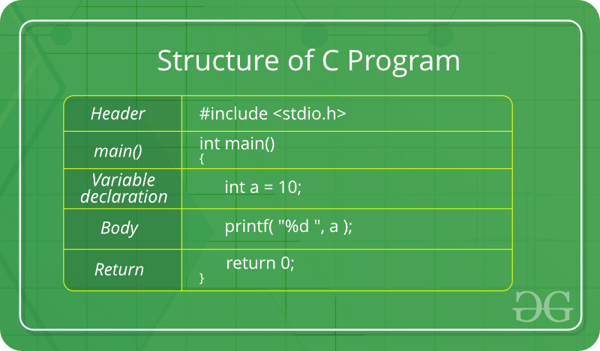
Structure of a C program

Slide 34
Escape Sequence in C
An escape sequence in C language is a sequence of characters that doesn't represent itself when used inside string literal or character.
It is composed of two or more characters starting with backslash \.
Escape Sequence | Meaning
\a | Alarm or Beep
\b | Backspace
\f | Form Feed
\n | New Line
\r | Carriage Return
\t | Tab (Horizontal)
\v | Vertical Tab
\\ | Backslash
\' | Single Quote
\" | Double Quote
\? | Question Mark

Slide 35
Comments in C
Comments in C
Comments in C language are used to provide information about lines of code. It is widely used for documenting code. There are 2 types of comments in the C language.
Single Line Comments
Single line comments are represented by double slash
E.g //
Multi-Line Comments
E.g /*
code
to be commented
*/

Slide 36
Variables in C
A variable is a name of the memory location. It is used to store data. Its value can be changed, and it can be reused many times.
It is a way to represent memory location through symbol so that it can be easily identified.
Let's see the syntax to declare a variable:
type variable_list;
The example of declaring the variable is given below:
-int roll_no ;
Int Roll1_;
char name ;
float marks ;
Here, roll_no, name, marks are variables.
The int, float, char are the data types.

Slide 37
Rules for defining variables
A variable can have alphabets, digits, and underscore.
A variable name can start with the alphabet, and underscore only. It can't start with a digit.
No whitespace is allowed within the variable name.
A variable name must not be any reserved word or keyword, e.g. int, float, etc.
A variable name does not contain the special symbol like
E.g #,$,*

Slide 38
Tokens in C
Tokens in C is the most important element to be used in creating a program in C.
We can define the token as the smallest individual element in C.
For `example, we cannot create a sentence without using words; similarly, we cannot create a program in C without using tokens in C. Therefore, we can say that tokens in C is the building block or the basic component for creating a program in C language.

Slide 39
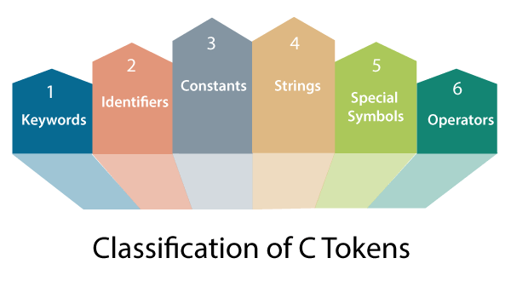

Slide 40
Keywords in C
A keyword is a reserved word. You cannot use it as a variable name, constant name, etc.
There are only 32 reserved words (keywords) in the C language.

Slide 41
auto | break | case | char | const | continue | default | do
double | else | enum | extern | float | for | g oto | if
int | long | register | return | short | signed | sizeof | static
struct | switch | typedef | union | unsignd | void | volatile | while

Slide 42
C Identifiers
C identifiers represent the name in the C program, for example, variables, functions, arrays, structures, unions, labels, etc.
An identifier can be composed of letters such as uppercase, lowercase letters, underscore, digits, but the starting letter should be either an alphabet or an underscore.
E.g er,Lr

Slide 43
Rules for constructing C identifiers
The first character of an identifier should be either an alphabet or an underscore, and then it can be followed by any of the character, digit, or underscore.
int roll_no;
It should not begin with any numerical digit.
In identifiers, both uppercase and lowercase letters are distinct. Therefore, we can say that identifiers are case sensitive.
Commas or blank spaces cannot be specified within an identifier.
Keywords cannot be represented as an identifier.
The length of the identifiers should not be more than 31 characters.
Identifiers should be written in such a way that it is meaningful, short, and easy to read.

Slide 44
Constants in C
A constant is a value assigned to the variable which will remain the same throughout the program, i.e., the constant value cannot be changed.
Types of constants in C
Constant | Example
Integer constant | 10, 11, 34, etc.
Floating-point constant | 45.6, 67.8, 11.2, etc.
Octal constant | 011, 088, 022, etc.
Hexadecimal constant | 0x1a, 0x4b, 0x6b, etc.
Character constant | 'a', 'b', 'c', etc.
String constant | "java", "c++", ".net", etc.

Slide 45
#include <stdio.h>
#include<conio.h>
void main()
{
int a=3,b=4; //Declaration with intialization
char g=‘a’; body
float f=3.4;
}

Slide 46
Special characters in C
Square brackets [ ]: The opening and closing brackets represent the single and multidimensional subscripts.
Simple brackets ( ): It is used in function declaration and function calling. For example, printf() is a pre-defined function.
Curly braces { }: It is used in the opening and closing of the code. It is used in the opening and closing of the loops.
Comma (,): It is used for separating for more than one statement and for example, separating function parameters in a function call, separating the variable when printing the value of more than one variable using a single printf statement.

Slide 47
Special characters in C
Hash/pre-processor (#): It is used for pre-processor directive. It basically denotes that we are using the header file.
Asterisk (*): This symbol is used to represent pointers and also used as an operator for multiplication.
Tilde (~): It is used as a destructor to free memory.
Period (.): It is used to access a member of a structure or a union.

Slide 48
Strings in C
Strings are nothing but an array of characters ended with a null character (‘\0’).
Eg .ram\0
This null character indicates the end of the string. Strings are always enclosed in double-quotes.
Char ‘a’
Char
Whereas, a character is enclosed in single quotes in C.
Declarations for String:
char roll[23] = {‘g’, ’e’, ‘e’, ‘k’, ‘s’, ‘f’, ‘o’, ‘r’, ‘g’, ’e’, ‘e’,\0 ‘k’, ‘s’, ‘\0’};
30
Ramm=20
char string[20] = “geeksforgeeks”;
char string [] = “geeksforgeeks\0”;
when we declare char as “string[20]”, 20 bytes of memory space is allocated for holding the string value.
When we declare char as “string[]”, memory space will be allocated as per the requirement during the execution of the program.

Slide 49
Operators in C
Operators in C is a special symbol used to perform the functions.
The data items on which the operators are applied are known as operands.
Operators are applied between the operands.
Depending on the number of operands, operators are classified as follows:
e.g A + b /4+ 6
Binary Operator
Unary Operator

Slide 50
Binary Operator
The binary operator is an operator applied between two operands.
The following is the list of the binary operators:
Arithmetic Operators
Relational Operators
Shift Operators
Logical Operators
Bitwise Operators
Conditional Operators
Assignment Operator
Misc Operator

Slide 51
Unary Operator
A unary operator is an operator applied to the single operand.
For example:
increment operator (++),
decrement operator (--),
sizeof, (type)*.

Slide 52
Arithmetic Operators in C:
C Arithmetic operators are used to perform mathematical calculations like addition, subtraction, multiplication, division and modulus in C programs.
Arithmetic Operators/Operation | Example
+ (Addition) | A+B
– (Subtraction) | A-B
* (multiplication) | A*B
/ (Division) | A/B
% (Modulus) | A%B

Slide 53
#include <stdio.h>
Void main()
{
int a=40,b=20, add,sub,mul,div,mod;
add = a+b;
sub = a-b;
mul = a*b;
div = a/b;
mod = a%b;
printf("Addition of a, b is : %d\n", add);
printf("Subtraction of a, b is : %d\n", sub);
printf("Multiplication of a, b is : %d\n", mul);
printf("Division of a, b is : %d\n", div);
printf("Modulus of a, b is : %d\n", mod);
}

Slide 54
Assignment operators in C:
In C programs, values for the variables are assigned using assignment operators.
int a=4,b=6;
For example, if the value “10” is to be assigned for the variable “sum”, it can be assigned as “sum = 10;”
There are 2 categories of assignment operators in C language. They are, 1. Simple assignment operator ( Example: = ) 2. Compound assignment operators ( Example: +=, -=, *=, /=, %=, &=, ^= )

Slide 55
Operators | Example/Description
= | sum = 10; 10 is assigned to variable sum
+= | sum += 10; This is same as sum = sum + 10
-= | sum -= 10; This is same as sum = sum – 10
*= | sum *= 10; This is same as sum = sum * 10
/= | sum /= 10; This is same as sum = sum / 10
%= | sum %= 10; This is same as sum = sum % 10
&=(Bitwise and assignment ) | sum&=10; This is same as sum = sum & 10
^=(Bitwise XOR assignment ) | sum ^= 10; This is same as sum = sum ^ 10

Slide 56
Int a=2,b=3,c;
a=3,b=2;

Slide 57
Algorithm : swapping of 2 no using a third variable
Step 1 : Start
Start 2 : READ num1=4, num2=3,temp
Start 3 : temp = num1
Start 4 : num1 = num2
Start 5 : num2 = temp
Start 6 : PRINT num1, num2
Start 7 : Stop

Slide 58
a=2
b=3
num1=3
num2=2
Num1=num1+num2 =3+2=5
Num2=num1-num2 = 5-2=3
Num1=num1-num2 =5-3=2

Slide 59
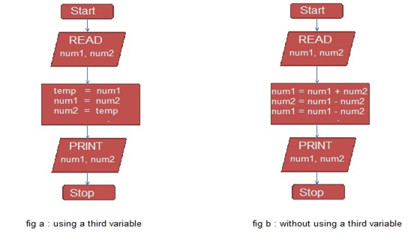
swapping of 2 no using a third variable

Slide 60
Write a one program to do swapping of 2 no without using a third variable
Algorithm : b. without using a third variable
Step 1 : Start
Start 2 : READ num1, num2
Start 3 : num1 = num1 + num2
Start 4 : num2 = num1 - num2
Start 5 : num1 = num1 - num2
Start 6 : PRINT num1, num2
Start 7 : Stop

Slide 61
Conditional Operators in C:
Conditional operators return one value if condition is true and returns another value is condition is false.
This operator is also called as ternary operator.
Syntax :
(Condition? expression 1: expression 2);
(Condition? true_value: false_value);
Example : (a>b ? a : b);
E.g. 4>6,5>3
In above example, if A is greater than b, a is returned as true else b is returned as false.
This is equal to if else conditional statements.

Slide 62
include <stdio.h>
#include<conio.h>
void main()
{
int a,b,c;
clrscr();
printf("Enetr the value of a & b\n");
scanf("%d%d",&a,&b);
c=(a>b?a:b);
printf("The greater value \n%d",c);
getch();
}

Slide 63
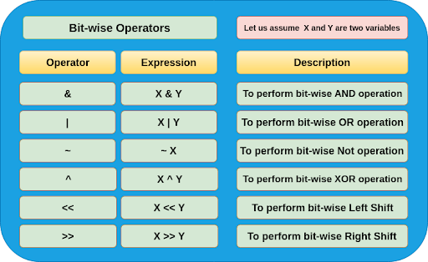
BIT-WISE OPERATOR

Slide 64
Decimal Binary
1 0001
2 0010
3 0011
4 0100
5 0101
6 0110
7 0111
8 1000 =0111
9 1001
10 1010

Slide 65
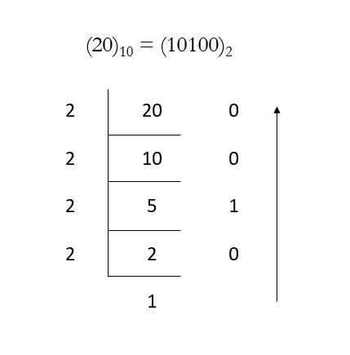
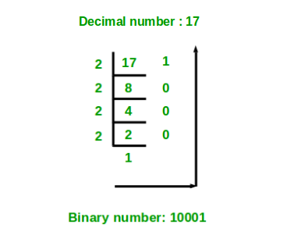
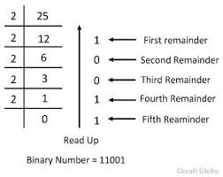
2- 4

Slide 66
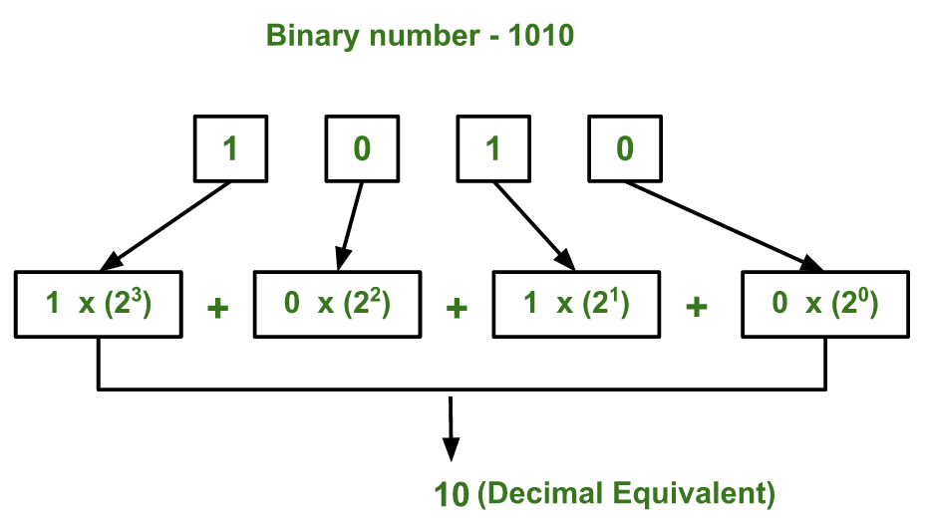
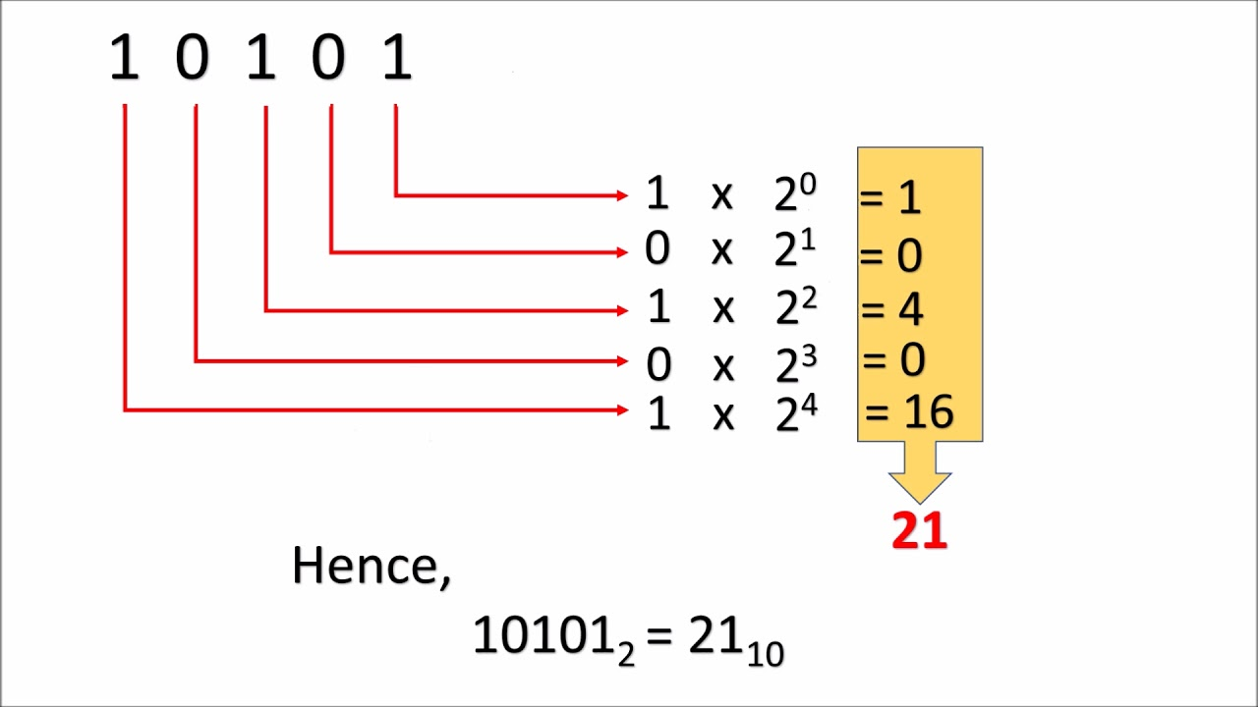
Binary to Decimal

Slide 67
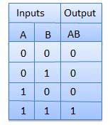
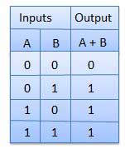
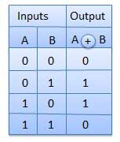
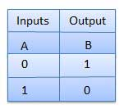
AND OR EXOR NOT

Slide 68
4 & 5
01 00
01 0 1
= 0 1 0 0 (4)
4 or 5
0 1 0 0
0 1 0 1
= 0 1 0 1 (5)

Slide 69
= 0 1
Left side operand will be shifted by 2 position
4<<2 (LEFT SHIFT)
0100
0 0 0 1 00 (8 bit)
000100 00=16
+1
= 0 1 0 1(5)

Slide 70
Logical not operator
As per compiler size
1byte=8bit, 2byte=16 bit, 4byte=32bit
So I consider it is 8 bit.
e.g) 10= 00001010
1’s complement10 =11110101
(MSB=most significant bit so we get negative sign i.e 1-negative,0-positive).
But our compiler stored only 2’s complement form .so how to calculate it
So again convert this 1’s complement to 2’s complement .
So again 11110101
00001010
+1
00001011 ans (-11)

Slide 71
Relational operators in C:
Relational operators are used to find the relation between two variables. i.e. to compare the values of two variables in a C program.
Note : double equal sign (==) should be used to compare 2 values. We should not single equal sign (=).
X==10
tr
Operators | Example/Description
> | x > y (x is greater than y)
< | x < y (x is less than y)
>= | x >= y (x is greater than or equal to y)
<= | x <= y (x is less than or equal to y)
== | x == y (x is equal to y)
!= | x != y (x is not equal to y)

Slide 72
Write a program for check whether given is Positive or Negative
#include <stdio.h>
int main()
{ int x;
printf("Enter a no");
scanf("%d",&x);
if(x>=0)
{ printf("Postitive");
}
else
printf("Negative");
}

Slide 73
Logical operators in C:
These operators are used to perform logical operations on the given expressions.
There are 3 logical operators in C language. They are, logical AND (&&), logical OR (||) and logical NOT (!).
Operators | Example/Description
&& (logical AND) | (x>5)&&(y<5)= (7>5)&&(6<5) It returns true when both conditions are true
|| (logical OR) | (x>=10)||(y>=10) It returns true when at-least one of the condition is true
! (logical NOT) | !((x>5)&&(y<5)) It reverses the state of the operand “((x>5) && (y<5))” If “((x>5) && (y<5))” is true, logical NOT operator makes it false

Slide 74
#include <stdio.h>
int main()
{
int x = 4, y = 10;
if ( (x>8)&&(y<7))
{
printf("Condition is true");
}
else printf("Condition is false");
}

Slide 75
UNARY OPERATOR
Increment /Decrement Operator
Size of operator

Slide 76
Increment and Decrement Operator in C
Increment Operators are used to increased the value of the variable by one and Decrement Operators are used to decrease the value of the variable by one in C programs.
Both increment and decrement operator are used on a single operand or variable, so it is called as a unary operator.
Unary operators are having higher priority than the other operators it means unary operators are executed before other operators.
++ // increment operator
-- // decrement operator
E.g ++4

Slide 77
Type of Increment /Decrement Operator
pre-increment/pre- Decrement
In pre-increment first increment the value of variable and then used inside the expression(initialize into another variable).
Syntax
++ variable;
A=++44=45
In pre-decrement first decrement the value of variable and then used inside the expression (initialize into another variable).
Syntax
-- variable;

Slide 78
PRG
#include <stdio.h>
#include<conio.h>
main()
{
int i=10,x;
x=++i;
printf("\n\nThe value of x=%d after preincremnt",x);
printf("\nThe value of i=%d after preincrement",i);
}
O/P
X=11
I=11

Slide 79
Post-increment
In post-increment first value of variable is used in the expression (initialize into another variable) and then increment the value of variable.
Syntax
variable++;
In Post-decrement first value of variable is used in the expression (initialize into another variable) and then decrement the value of variable.
Syntax
Variable--;

Slide 80
#include<stdio.h>
#include<conio.h>
void main()
{
int x,i;
i=10;
x=++i;
printf("x: %d",x);
printf("i: %d",i);
getch();
}

Slide 81
Size of operator
The sizeof operator is used to calculate the size of data type or variables. This operator returns the size of its variable in bytes.
For example:
sizeof(a), where a is interger, will return 4.
Ass 3

Slide 82
#include<stdio.h>
#include<conio.h>
void main()
{
int a,f;
float b;
double c;
char d;
f=sizeof(a);
printf("Size of Integer: %d bytes\n",f);
printf("Size of float: %d bytes\n",sizeof(b));
printf("Size of double: %d bytes\n",sizeof(c));
printf("Size of character: %d byte\n",sizeof(d));
getch();
}

Slide 83
Expression Evaluation in C
In c language expression evaluation is mainly depends on priority and associativity.
An expression is a sequence of operands and operators that reduces to a single value.
For example,
the expression, 10+15 reduces to the value of 25.
An expression is a combination of variables constants and operators written according to the syntax of C language.
every expression results in some value of a certain type that can be assigned to a variable.

Slide 84
Priority
This represents the evaluation of expression starts from "what" operator.
Associativity
It represents which operator should be evaluated first if an expression is containing more than one operator with same priority.
2+5+(6/7)%89[4*6]

Slide 85
Operator | Priority | Associativity
{}, (), [] | 1 | Left to right
++, --, ! | 2 | Right to left
*, /, % | 3 | Left to right
+, - | 4 | Left to right
<, <=, >, >=, ==, != | 5 | Left to right
&& | 6 | Left to right
|| | 7 | Left to right
?: | 8 | Right to left
=, +=, -=, *=, /=, %= | 9 | Right to left

Slide 86
{2+3}/[6+7]= 5 / 13

Slide 88
10-3%8+6/4
10- 3%8 + 6/4
10-3+6/4
10-3+1
7+1
8

Slide 89
6*2/ (2+1 * 2/3 + 6) + 8 * (8/4)
Evaluation of expression | Description of each operation
6*2/( 2+1 * 2/3 +6) +8 * (8/4) | An expression is given.
6*2/(2+2/3 + 6) + 8 * (8/4) | 2 is multiplied by 1, giving value 2.
6*2/(2+0+6) + 8 * (8/4) | 2 is divided by 3, giving value 0.
6*2/ 8+ 8 * (8/4) | 2 is added to 6, giving value 8.
6*2/8 + 8 * 2 | 8 is divided by 4, giving value 2.
12/8 +8 * 2 | 6 is multiplied by 2, giving value 12.
1 + 8 * 2 | 12 is divided by 8, giving value 1.
1 + 16 | 8 is multiplied by 2, giving value 16.
17 | 1 is added to 16, giving value 17.

Slide 90
Types of Expression Evaluation in C
Based on the operators and operators used in the expression, they are divided into several types. Types of Expression Evaluation in C are:
Integer expressions – expressions which contains integers and operators
Real expressions – expressions which contains floating point values and operators
Arithmetic expressions – expressions which contain operands and arithmetic operators
Mixed mode arithmetic expressions – expressions which contain both integer and real operands
Relational expressions – expressions which contain relational operators and operands
Logical expressions – expressions which contain logical operators and operands
Assignment expressions and so on… – expressions which contain assignment operators and operands

Slide 91
END OF UNIT 2

